Slide 1
Twitter Real-Time Data Analysis
By
Venkata Naga Sri Sahithi Mulukutla
Venkata Reddy Kovvuri
Gagan M
Yeswanth Yuppalapati

Slide 2
Agenda
Introduction
Tech Stacks
Spark Overview
Getting Started
Kafka Overview
Code
Challenges
Conclusion

Slide 3
Description
Kafka is the tool most used to read streaming data. It follows a publish-subscribe model where you write messages (publish) and read them (subscribe). Messages are grouped into topics. As messages are consumed, they are removed from Kafka.
Since this data coming is as a stream, it makes sense to process it with a streaming product, like Apache Spark Streaming. That keeps data in memory without writing it to storage, unless you want to. But streaming data has value when it is live, i.e., streaming. So there would not be much reason to store that data permanently to some place like Hadoop.

Slide 4
Project Overview
Our Project deals with trending hashtags in twitter using Kafka and Spark Streaming.
Here we are grouping the data from the Twitter and storing in Kafka topic and streaming with help of Spark Streaming
The Streaming data is organized into Batches that are updated from previous batches respective to the trending hashtags

Slide 5
Major Tech Stacks
Python
Kafka
Spark Streaming

Slide 6
PySpark
PySpark in an interactive shell for Spark in Python.
The Python shell can be used explore data interactively and is a simple way to learn the API.
By default, the bin/pyspark shell creates SparkContext that runs applications.
In PySpark, RDDs(Resilient Distributed Dataset) support the same methods as their Scala counterparts but take Python functions and return Python collection types.
Spark revolves around the concept of a resilient distributed dataset (RDD), which is a fault-tolerant collection of elements that can be operated on in parallel.

Slide 7
Spark Streaming
Framework for large scale stream processing
Scales to 100s of node
Can achieve second scale latencies
Integrates with Spark’s batch and interactive processing
Provides a simple batch-like API for implementing complex algorithm
Can absorb live data streams from Kafka etc.

Slide 8
Kafka
It is a messaging system
Fault tolerant messaging system
Pub-sub based fault tolerant messaging system.
It is an event streaming platform.
OPEN-SOURCE APACHE PROJECT.
Features:
High throughput
built-in partitioning
replication ( 3 by default) Fault tolerant
Durability/availability
High speed. Performs 2 million writes/sec.

Slide 9
Kafka Topic
Events are organized and durably stored in topics.
A stream of messages belonging to a particular category. Data is stored in topics.
Topics are split into partitions. For each topic, Kafka keeps a minimum of one partition.
Each such partition contains messages in an immutable ordered sequence.
A partition is implemented as a set of segment files of equal sizes.
Very simplified, a topic is similar to a folder in a file system, and the events are the files in that folder.
Topics in Kafka are always multi-producer and multi-subscriber.
Create a topic: Open a new prompt in kakfa location and give the following command.
$ bin/kafka-topics.sh --create
--zookeeper localhost:2181
--replication-factor 1
--partition 1
--topic kafkatopic

Slide 10
Methodology
Created Kafka Producer which was use to publish data to twitter topic.
Used the twitter API to get the twitter data.
Simulate real time data using twitter developer api.
We used PySpark program to run the spark SQL queries along with their required dependencies.
Used Kafka Consumer to get the data from the topic “twitter”.
Grouped the trending hashtags into batches.

Slide 11
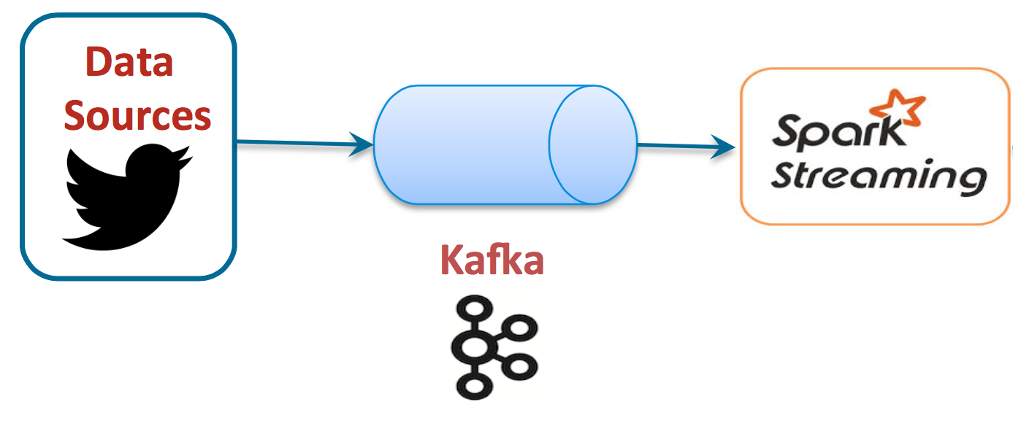
Project Working

Slide 12




Project Flow
Data Source
The Streaming data is coming from Twitter
Processing
The Data is processed that the required data is taken into Kafka topic
Streaming
The data is Streamed from Kafka topic using Spark Streaming
Outcome
The data is released in batches with respective to trending hashtags

Slide 13
Code

Slide 14
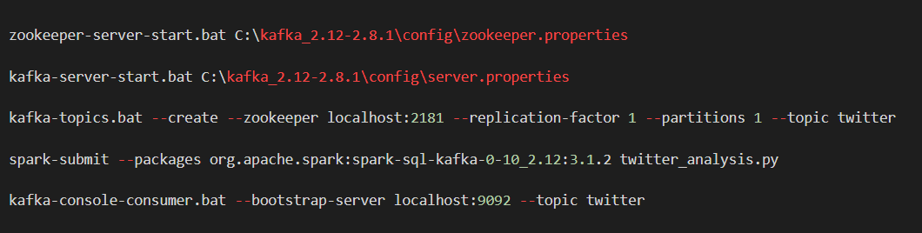
Prerequisites for running the Project

Slide 15
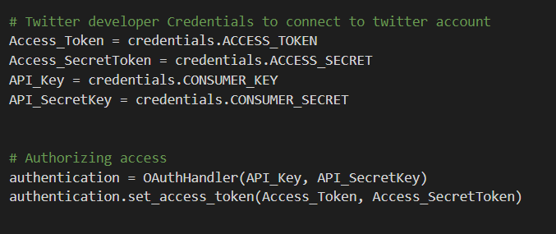
Connecting and Accessing data from Twitter

Slide 16

Code for Twitter Stream Listening

Slide 17
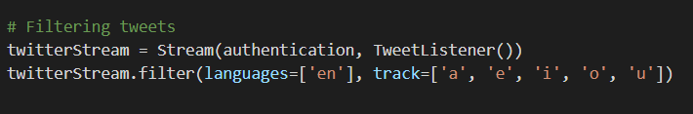
Filtering the Twitter Stream Data

Slide 18
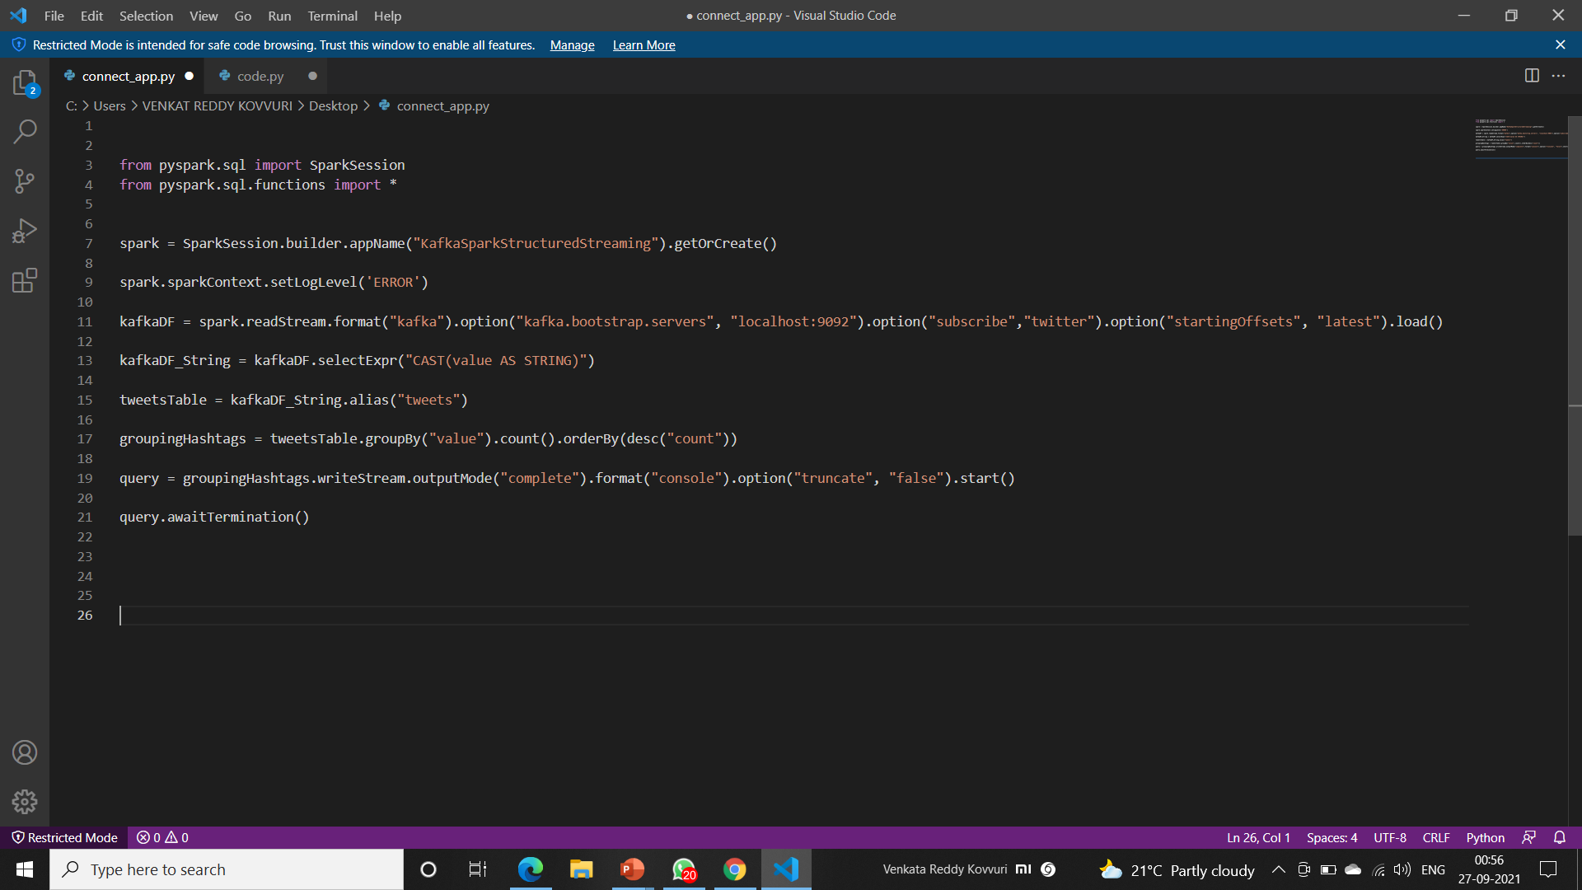
Creating SparkSession and Subscribe Kafka Topic

Slide 19
Grouping the hashtags and making a batch using Spark SQL

Slide 20
Ouput

Slide 21
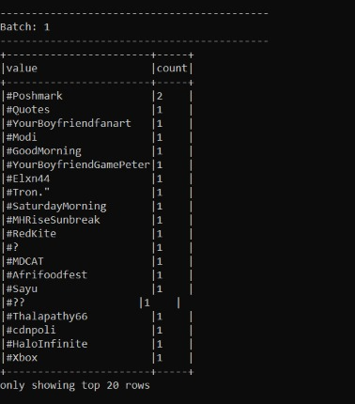
Batch1-Trending Hashtags

Slide 22
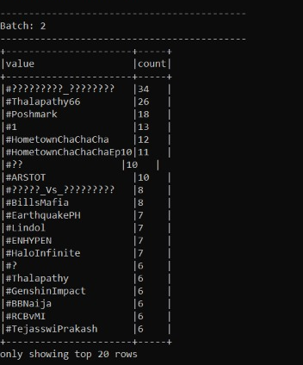
Batch2-Trending Hashtags

Slide 23
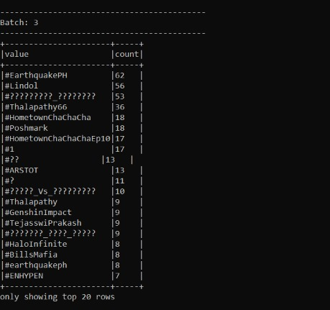
Batch3-Trending Hashtags

Slide 24
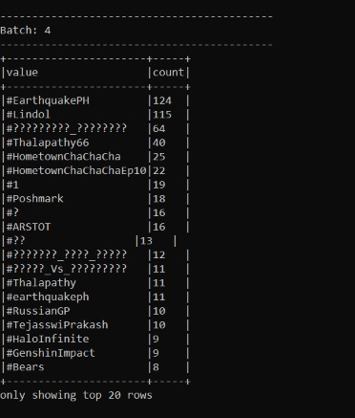
Batch4-Trending Hashtags

Slide 25
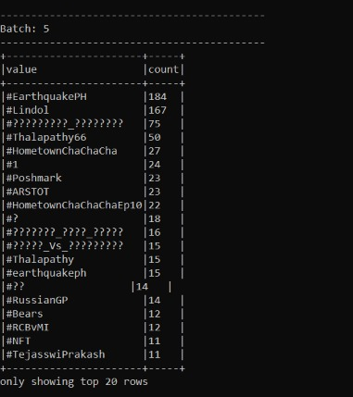
Batch5-Trending Hashtags

Slide 26

Challenges
Difficulties in fetching the data from Twitter API.
Faced problems while setting up the dependencies of the project like Kafka and Spark
Spark submit failed due to missing package to integrate Kafka with Spark.
Was unable to get the spark streaming.
The Output batches was not updating in streaming

Slide 27
Conclusion
Spark Streaming and Kafka integration can offer some pretty robust features for your data streaming requirements
The Twitter data can be inconsistent so that we are applying operations on data and with the help of Spark Streaming we Stream the data.
Kafka Stream refers to a client library that lets you process and analyzes the data inputs that received from Kafka and sends the outputs either to Kafka or other designated external system.

Slide 28




TEAM PRESENTATION
Venkata Naga Sri Sahithi
Venkata Reddy Kovvuri
Gagan N
Yeswanth Vuppalapati

Slide 29
Thank You

